Slide 1


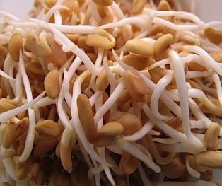
Breaking Paradigms The German STEC outbreak
Professor Mark Pallen

Slide 2
Breaking paradigms
Paradigm 1: infection not a threat to advanced societies
Paradigm 2: bacterial genome sequencing is a slow expensive onerous task
Paradigm 3: serious science is done behind closed doors and social media is just for gossip
Paradigm 4: pathogens fall into tidy pathotypes
Paradigm 5: you have to grow pathogens to detect and characterise them
Paradigm 6: pathogens work as single spies, not in battalions

Slide 3
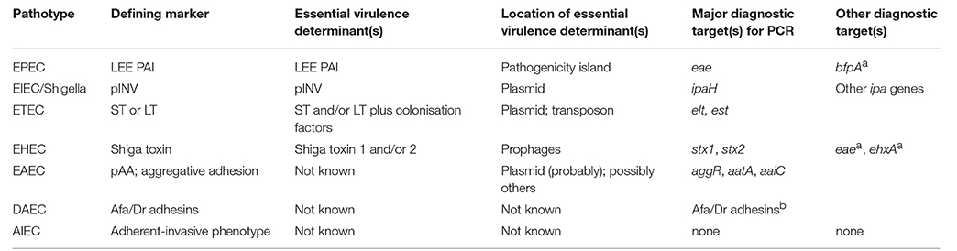
E. coli pathotypes
https://www.frontiersin.org/articles/10.3389/fcimb.2016.00141/full

Slide 4
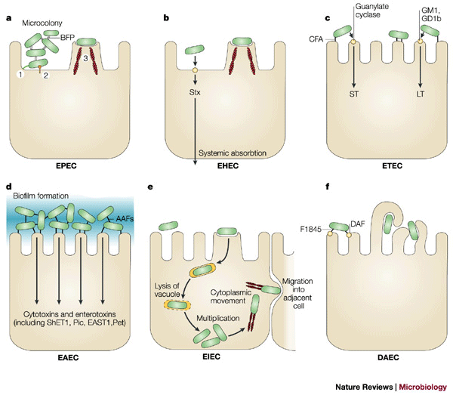
https://www.nature.com/articles/nrmicro818

Slide 5
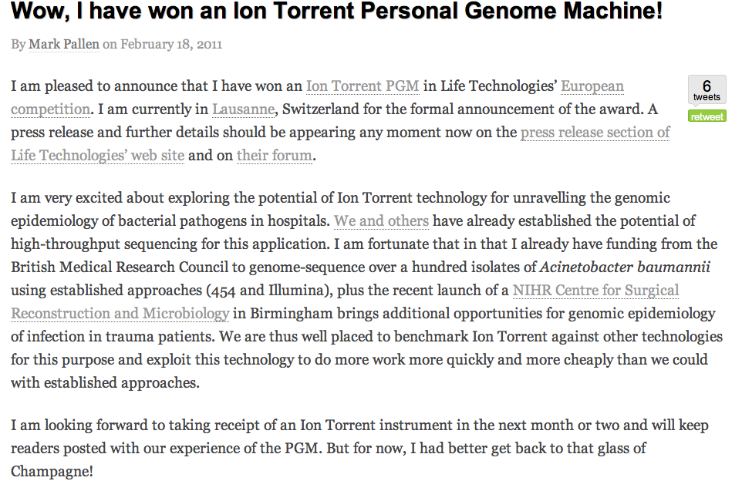
Our story begins...

Slide 6
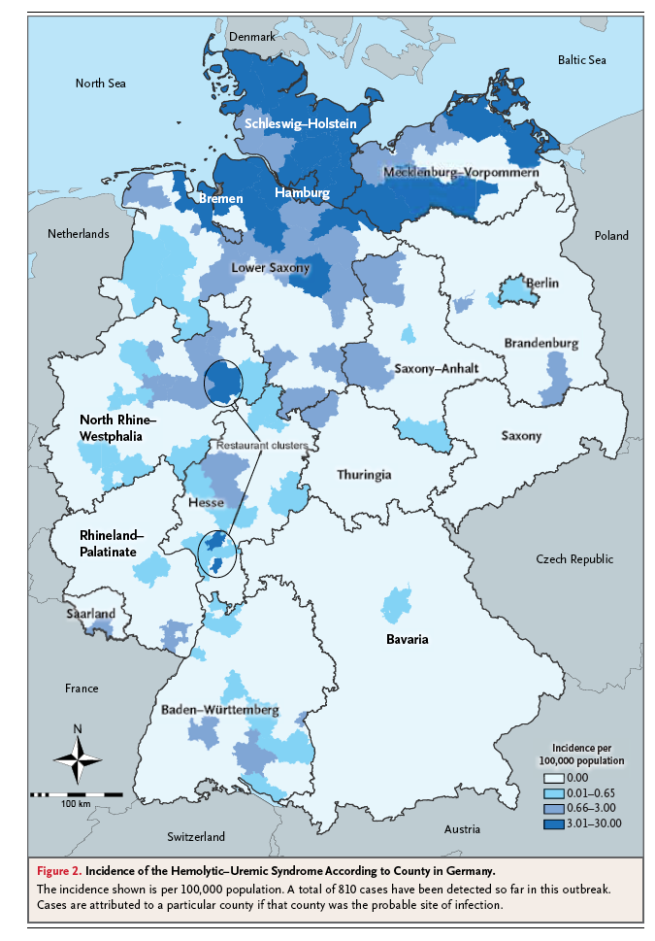
The E. coli O104:H4 sproutbreak
May-June 2011
>5000 cases
>50 deaths
Link to sprouting seeds
High risk of haemolytic-uraemic syndrome
Females particularly at risk
Infection still presents threat even in the most advanced societies!

Slide 7
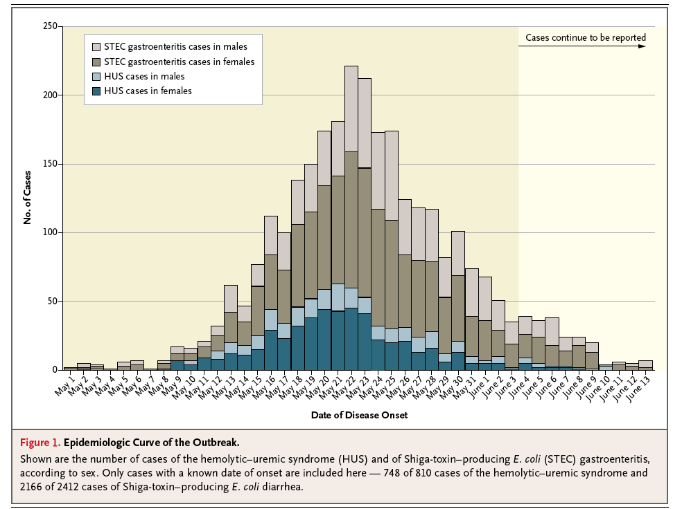
Frank et al DOI: 10.1056/NEJMoa1106483

Slide 8
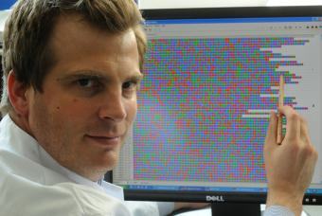
“Calling International Rescue…”
Herr Doktor Holger Rohde
UKE Universitätsklinikum Hamburg-Eppendorf

Slide 9
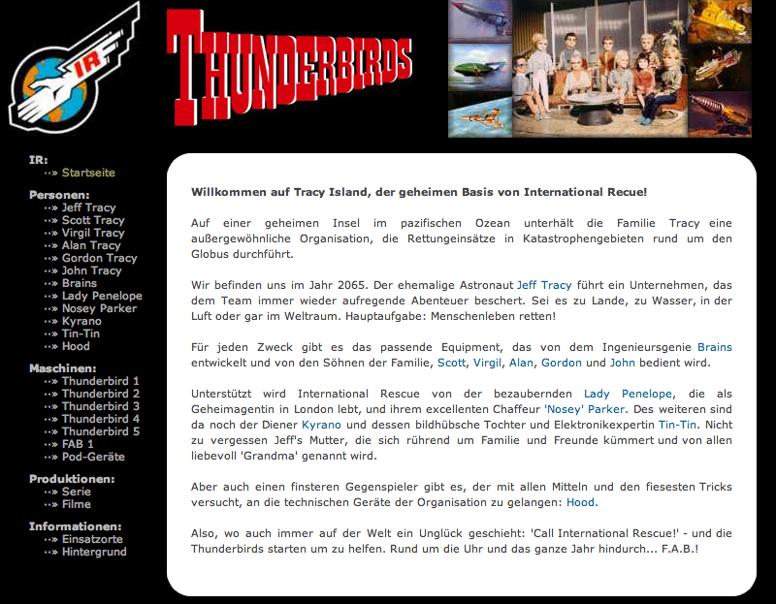
“Calling International Rescue…”

Slide 10
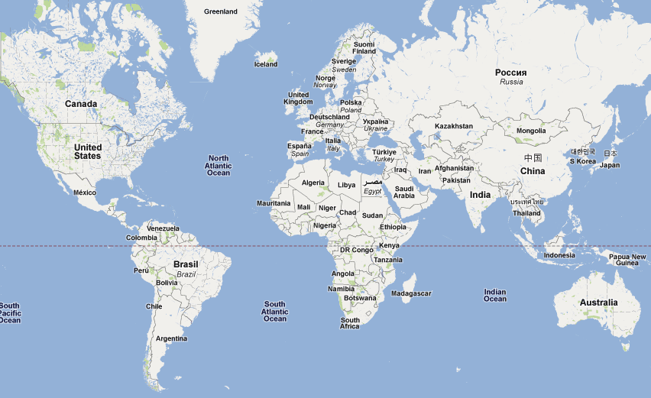

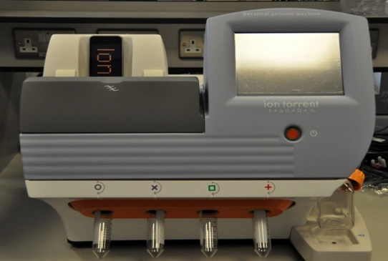
UKE Hamburg
BGI-Shenzhen

Slide 11



Informationen wollen frei sein!
Data ad libertatem tendunt!
信息要免费!
Scott Edmunds, Yingrui Li, YuJun Cui

Slide 12
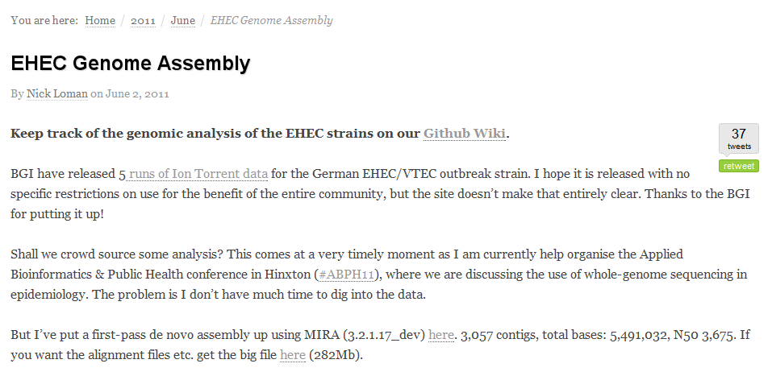

Crowd-sourcing the genome

Slide 13
Crowd-sourcing the genome
Within 24 hours of its release, the genome is assembled
Within two days, assigned to an existing lineage
Within five days, strain-specific diagnostic test released
Within a week, two-dozen reports on the biology and evolution of the strain had been filed on an open-source wiki

Slide 14
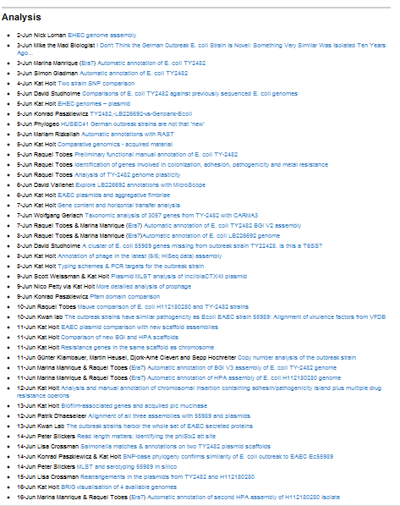



Slide 15

“Calling International Rescue…”

Slide 16
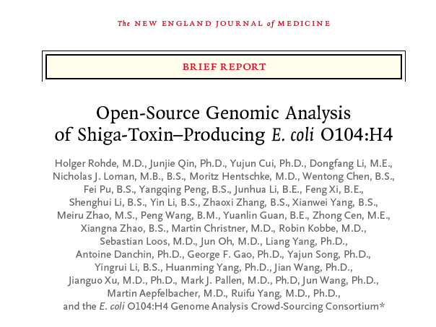
Squaring the circle…
A few Tweets and blog posts do not equate to a peer-reviewed research publication
Paper for NEJM written up to include
Case study of a family
“Journey”, not just destination
Analyses all repeated in house by Nick Loman
Problems with what to include and who to include from crowdsourcers

Slide 17
Take-away messages
A new Weltanschauung? A new Zeitgeist?
Social media (blogging, Twitter) can augment usual channels of academic discourse
Open-Source Genomics: a propitious confluence of
high-throughput genomics
crowd-sourced analyses
a liberal approach to data release
Key role for benchtop sequencers…
Laid the groundwork for Covid!

Slide 18
Take-away messages
Pathogens don’t bother with passports!
Not a new strain: something similar seen in Germany ten years ago and in Korea
closest genome-sequenced strain from Central African Republic in late 1990s; from enteroaggregative lineage
Yet another challenge to typological thinking!
Pathotypes can overlap and evolve
Virulence factors in E. coli can jump from one lineage to another on mobile genetic elements
STEC can cause disease without the LEE!
Antibiotic resistance seen where no obvious prior use of antibiotics

Slide 19
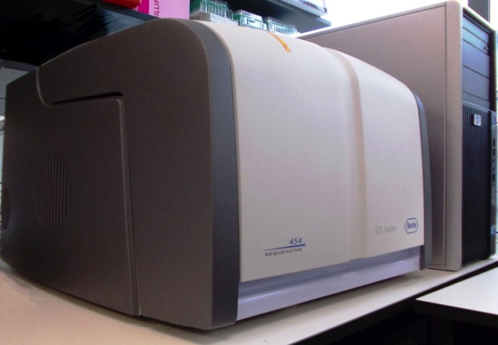

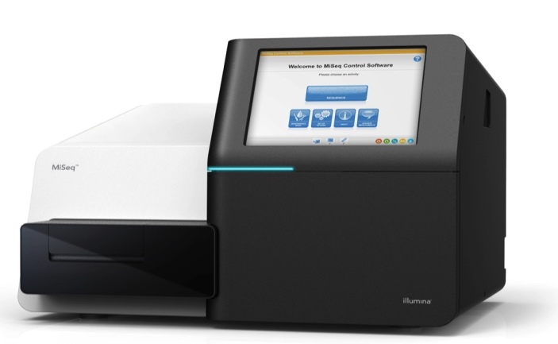
Benchtop sequencers
454Jr
Ion Torrent
MiSeq
Q1 2010
Q1 2011
Q3 2011

Slide 20

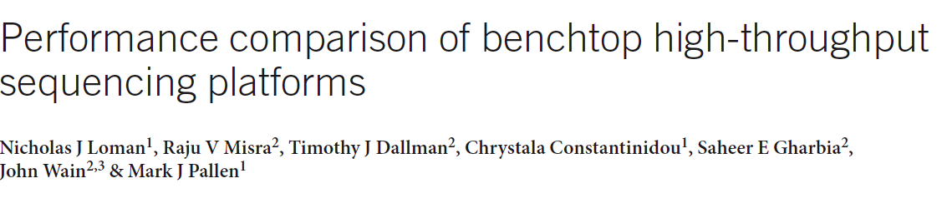
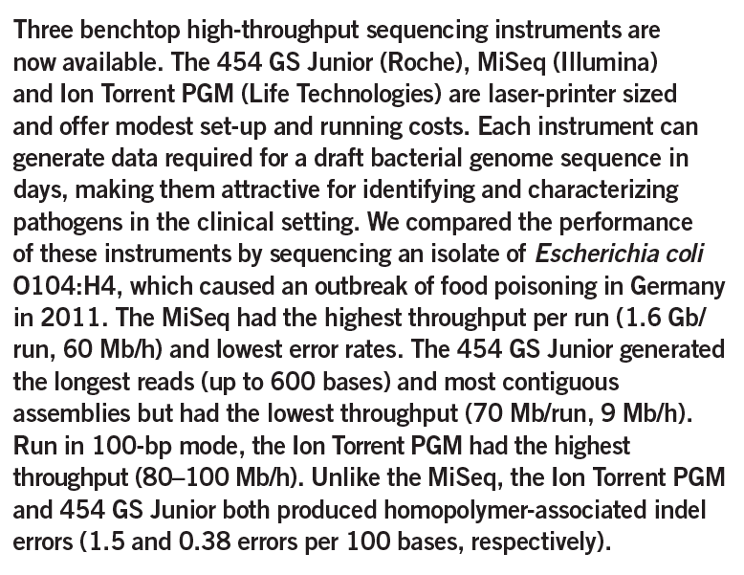
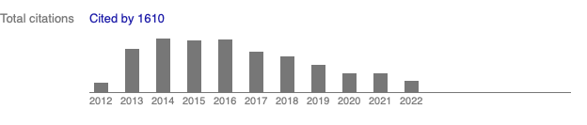

Slide 21
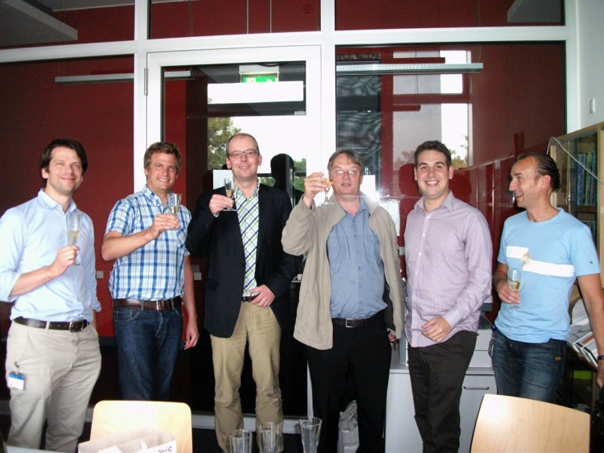
Over to Germany But where next…?

Slide 22
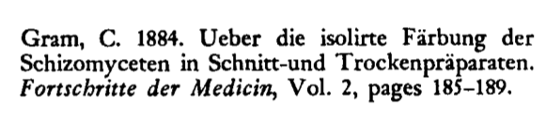
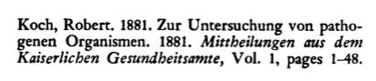
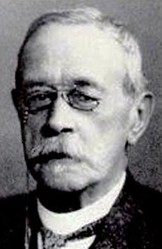
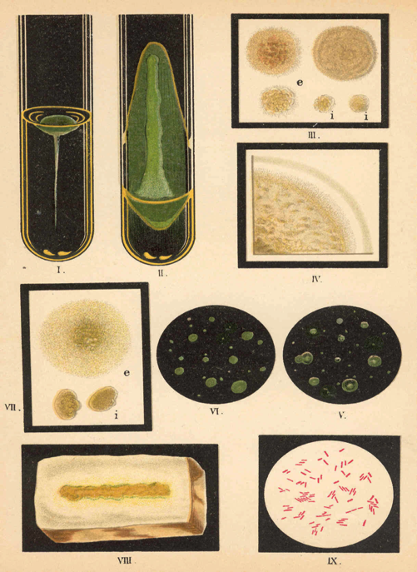
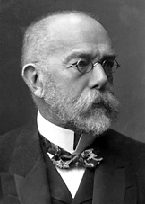
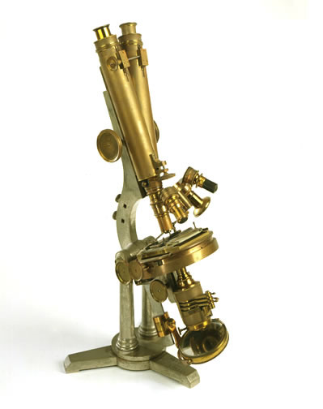
Evolution of Technology 21st century problems, but 19th century techniques!

Slide 23
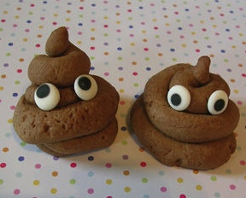
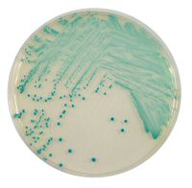
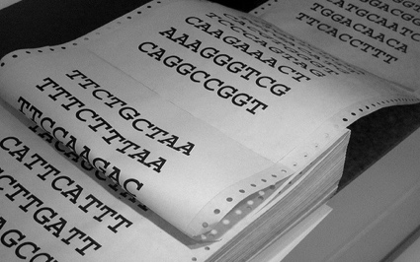
Shotgun Metagenomics: direct sequencing of DNA extracted from a sample without culture, amplification or capture
Diagnostic Metagenomics: application of metagenomics to human or animal samples

Slide 24
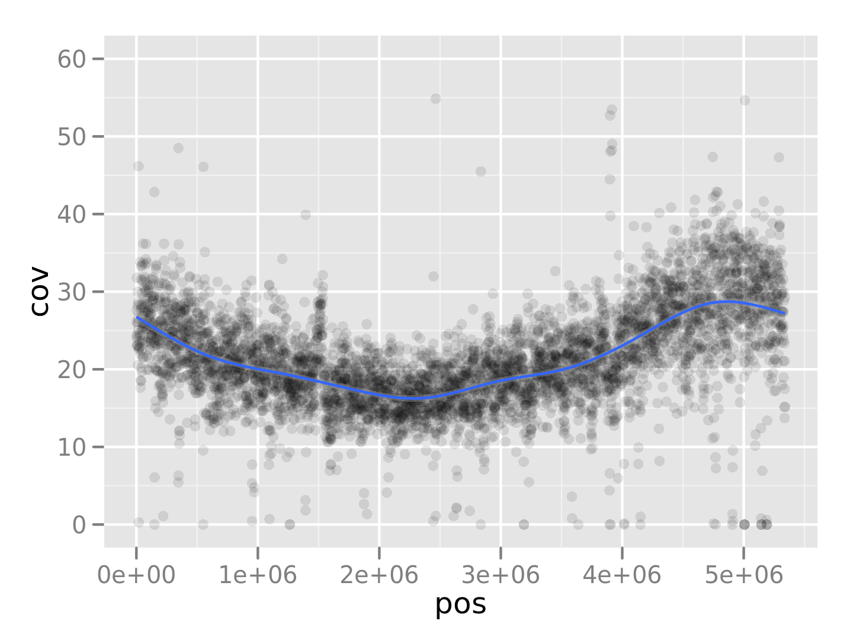
The first sample we looked at…
Vs. 280 O104:H4
>20x coverage
But note peak-to-trough skew
Indicates active growth
Stx2 detected
Evidence of phage lysis?
In silico MLST retrieves ST678 profile
Shiga-toxin encoding phage
1m
2m
3m
4m
5m

Slide 25

The vibes from JAMA: Fail!
Too few samples
Underpowered!
Sensitivity only 67%
A lousy test!
Retrospective
Cheating to use outbreak strain genome
Should be done as if blind to cause of outbreak
Deeper, Smarter…

Slide 26

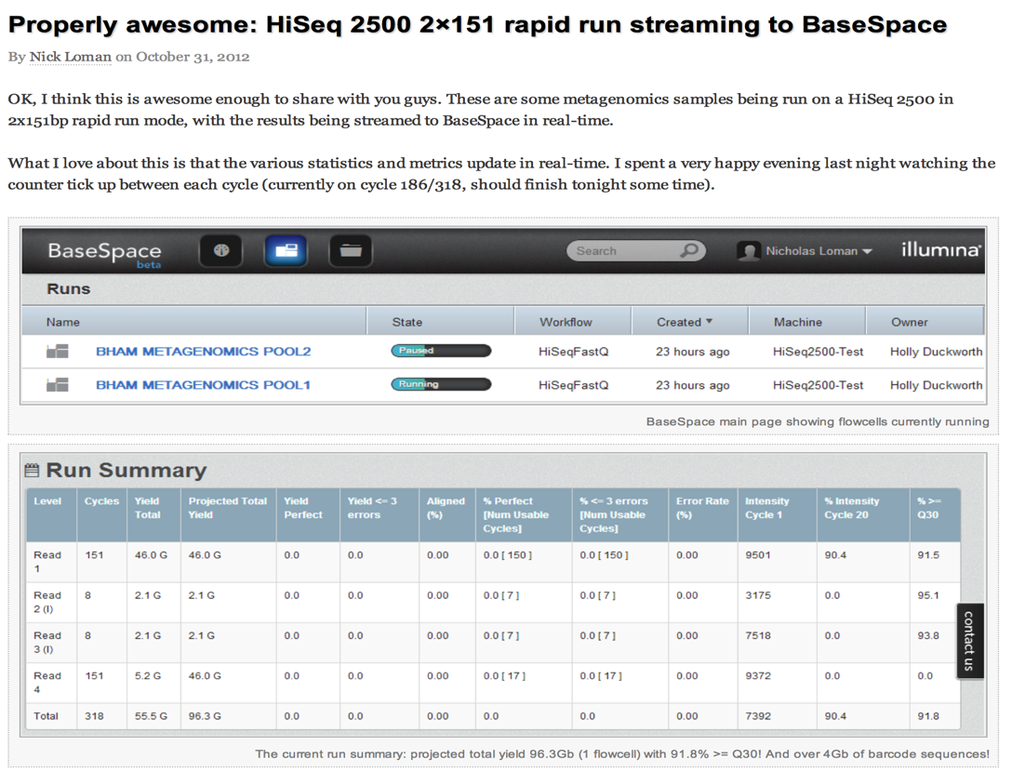
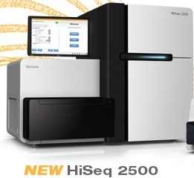
Geoff Smith to the rescue…!
Notes:
Ended up exchanging hard drives in Coventry

Slide 27
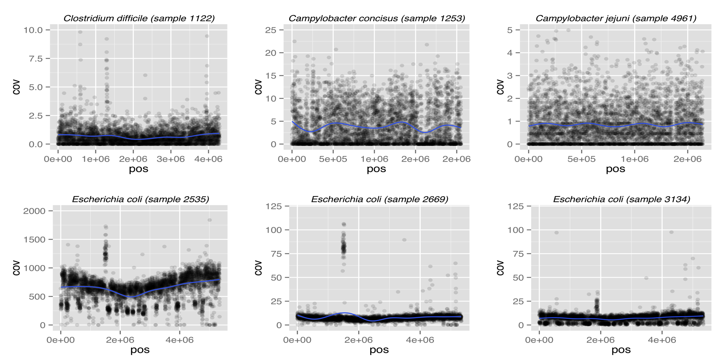

Slide 28
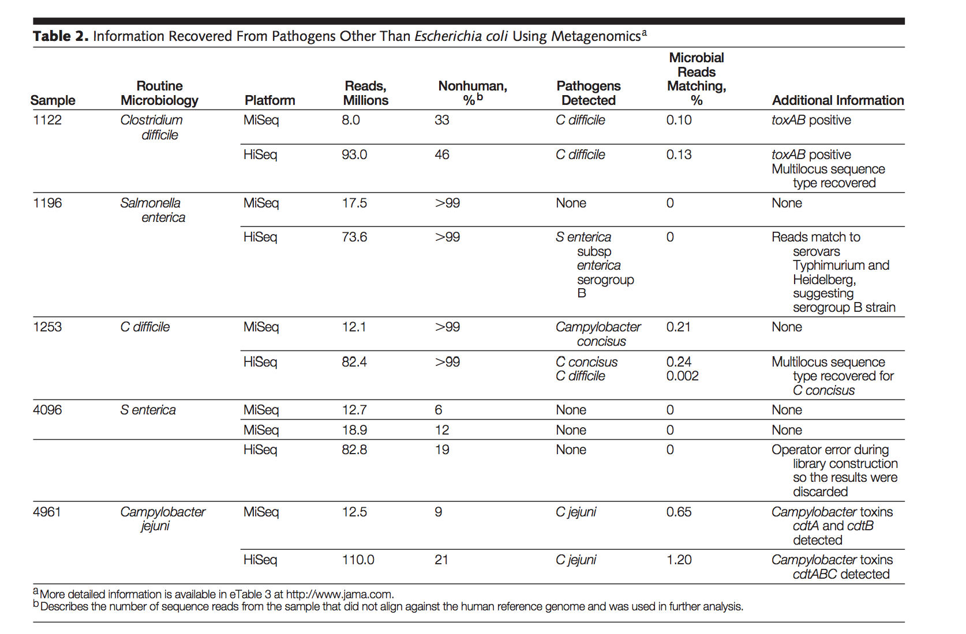

Slide 29
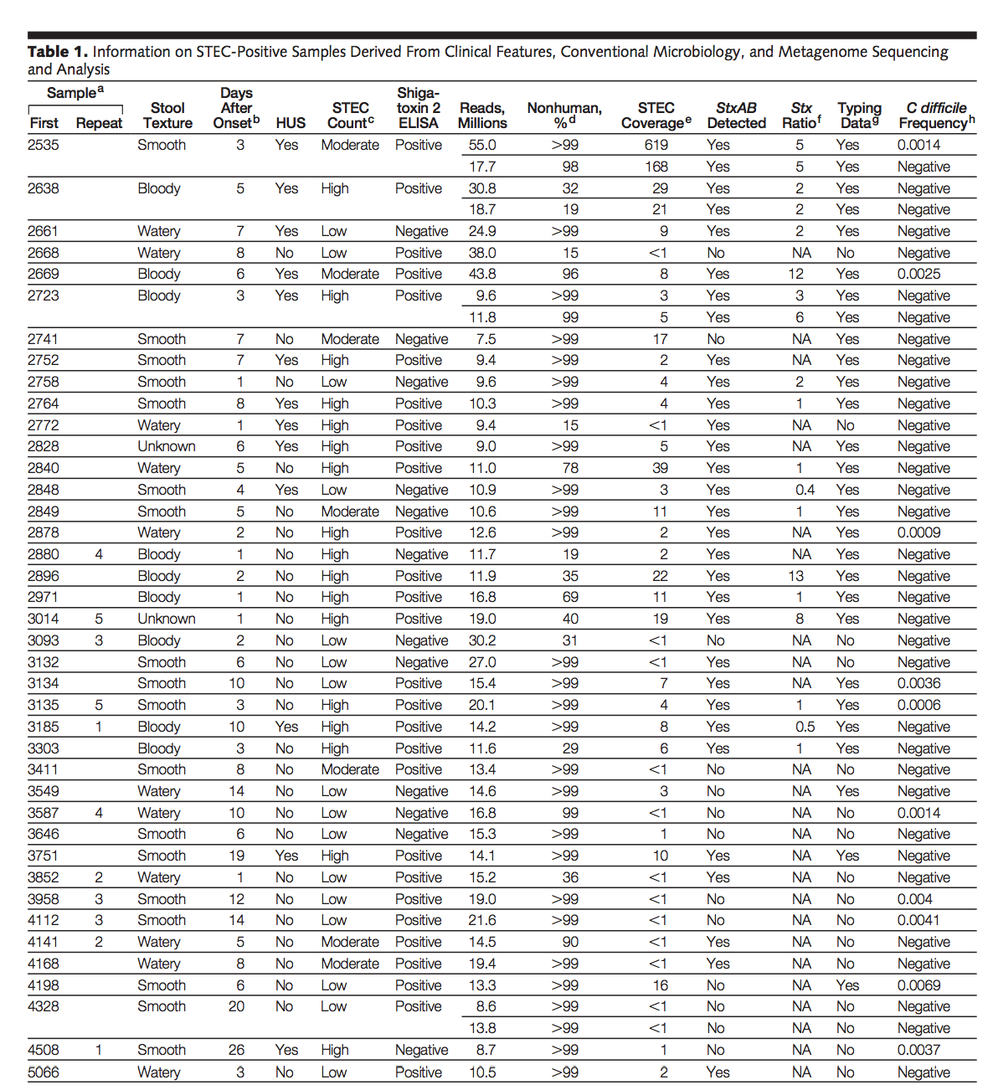
Still only
67% sensitivity

Slide 30

Instead of asking how we might use metagenomics to make an individual diagnosis, let’s ask how we might it to identify the cause of an outbreak

Slide 31
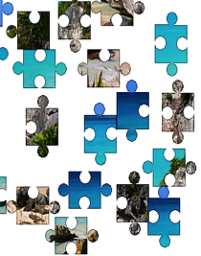
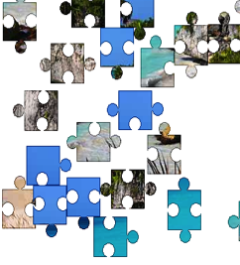

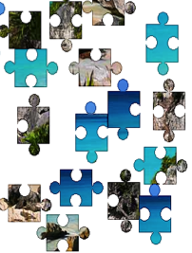


But aligning against known genome is cheating….
Like solving a jigsaw puzzle by using the lid
Can we get the outbreak strain genome without knowing in advance what it looks like?

Slide 32
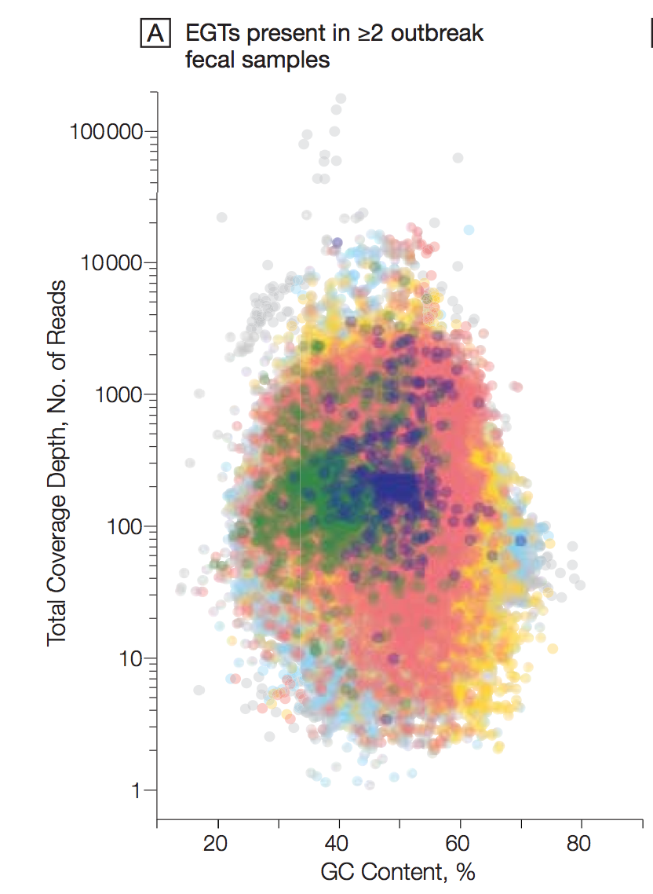

Slide 33
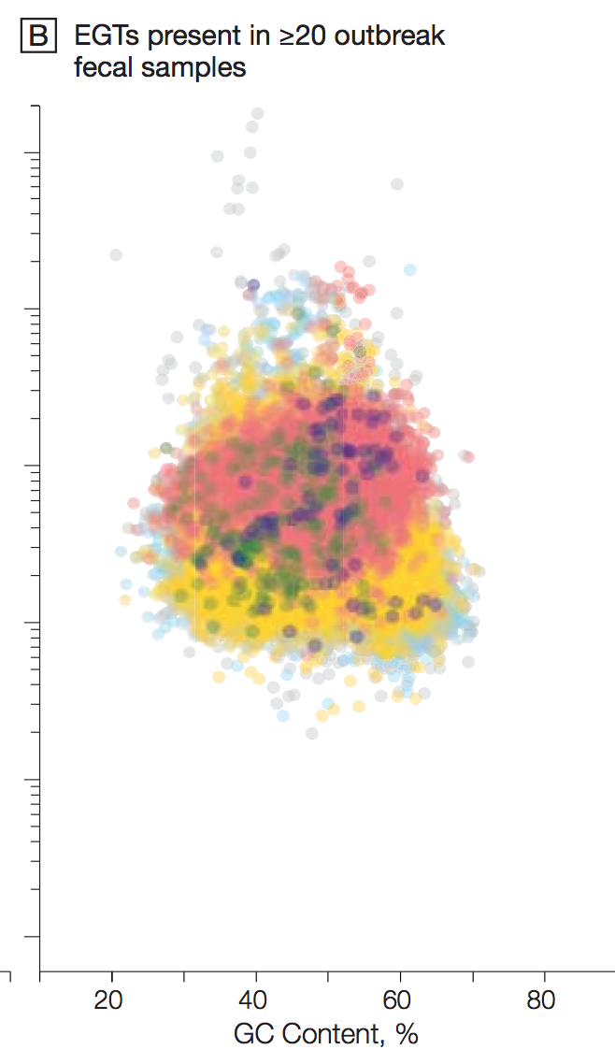

Slide 34
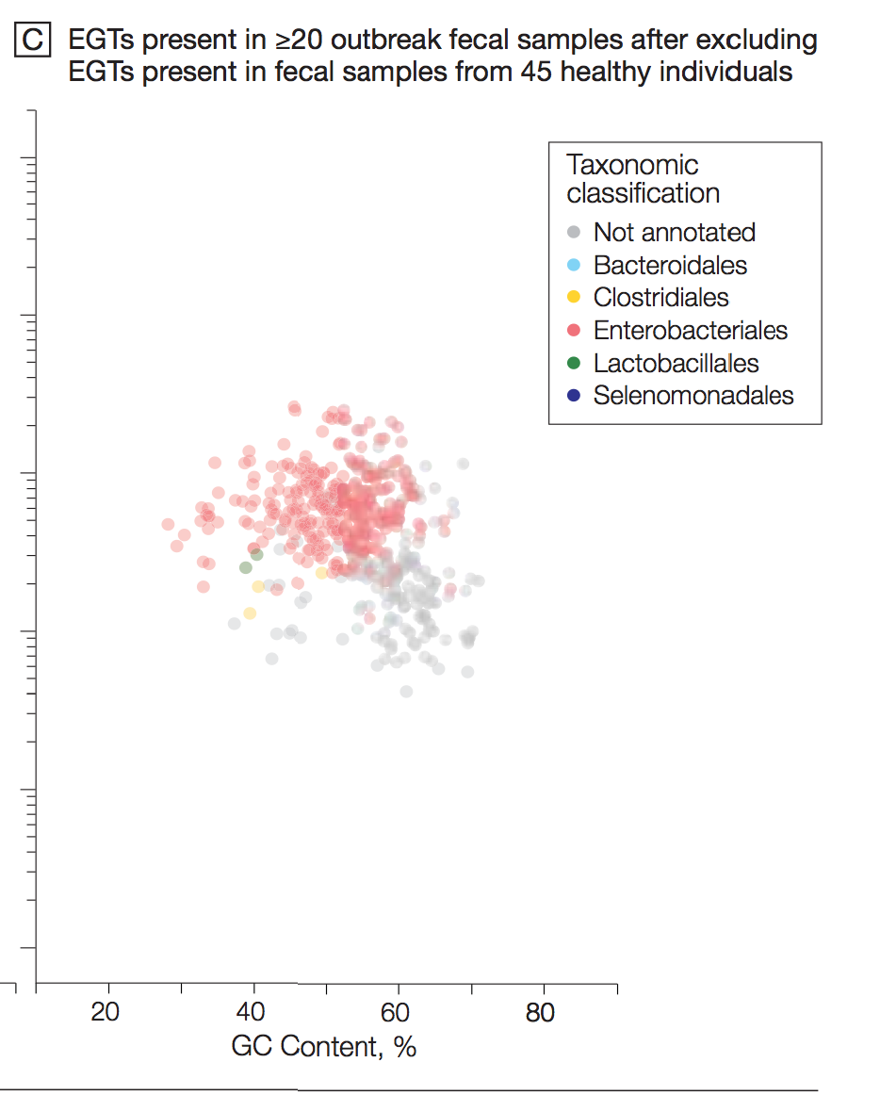

Slide 35
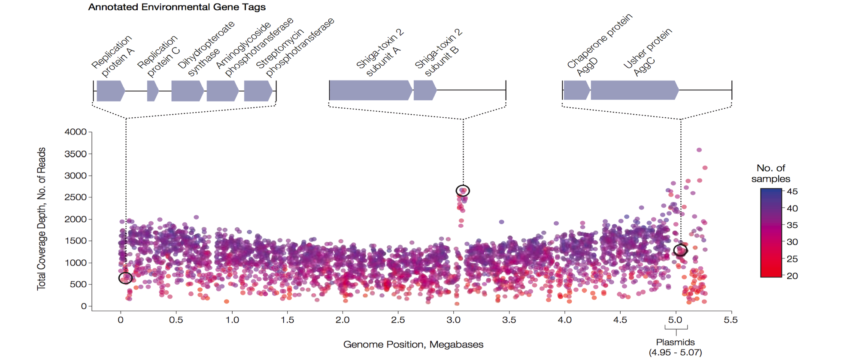
Loman NJ, Constantinidou C, Christner M, Rohde H, Chan JZ, Quick J, Weir JC, Quince C, Smith GP, Betley JR, Aepfelbacher M, Pallen MJ. A culture-independent sequence-based metagenomics approach to the investigation of an outbreak of Shiga-toxigenic Escherichia coli O104:H4. JAMA. 2013 Apr 10;309(14):1502-10.

Slide 36
Breaking paradigms
Paradigm 1: infection not a threat to advanced societies
Paradigm 2: bacterial genome sequencing is a slow expensive onerous task
Paradigm 3: serious science is done behind closed doors and social media is just for gossip
Paradigm 4: pathogens fall into tidy pathotypes
Paradigm 5: you have to grow pathogens to detect and characterise them
Paradigm 6: pathogens work as single spies, not in battalions

Slide 37

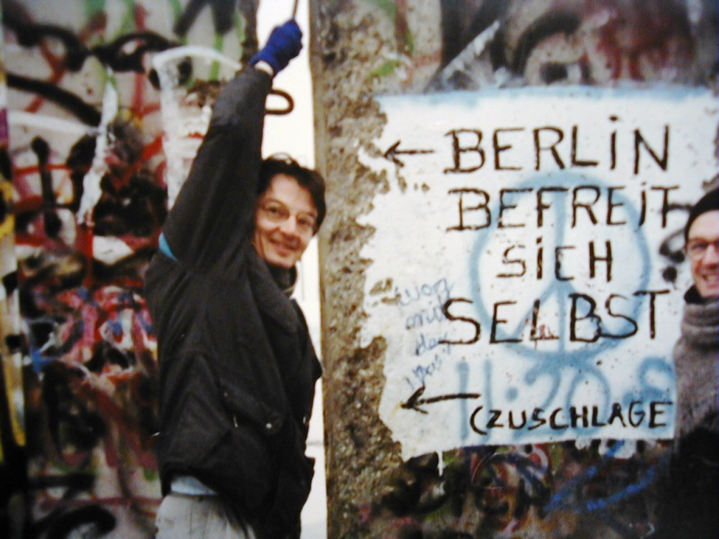
“The aim of science is to seek the simplest explanations of complex facts. We are apt to fall into the error of thinking that the facts are simple because simplicity is the goal of our quest. The guiding motto in the life of every natural philosopher should be, 'Seek simplicity and distrust it.”
Alfred North Whitehead
https://www.youtube.com/watch?v=k5HfOipwvts

